Slide 1

Feminine Technology (FemTech) and Fertility Health Monitoring
Presented by: Mary Schneider PhD, FNP, MMCP
BOLAND INSTITUTE FOR NATURAL FAMILY PLANNING

Slide 2
Purpose of this presentation
Provide a brief overview of the new area of digital science called FemTech through:
historical and future activities
Review of the HPO system related to reproduction
Review of different digital health devices
  urine hormone devices (quantitative and qualitative)
  Wearables
  mHealth apps (mobile apps)
Ethical concerns related to digital devices, marketing and HC regulations.
MARQUETTE UNIVERSITY l College of Nursing I Boland Institute for NFP

Slide 3
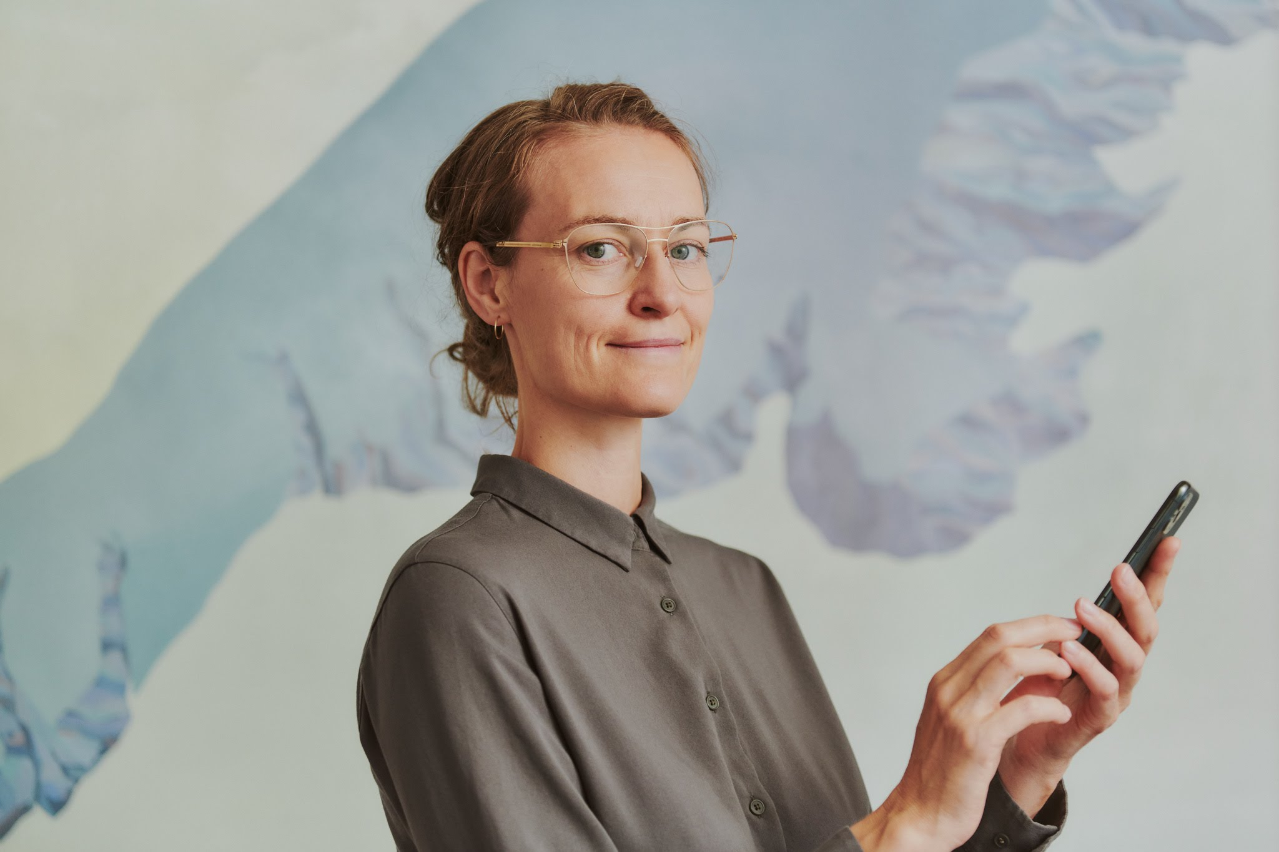

FemTech: Origins
Subset of Digital health (e.g., mHealth)
Fertility health or feminine health
Ida Tin- digital health engineer
developer of Clue 2015.
Clue – 10 million users, 190 countries
worth about $23 million.
“technology brings awareness to the
invisible in women’s bodies”
MARQUETTE UNIVERSITY l College of Nursing I Boland Institute for NFP
Notes:
Ida Tin – born in Copenhagen Denmark now lives in Germany and graduated with a business degree.
she coined the word “femtech” 2015-16
To date Clue has over 1 million paid subscribers.
Clue Clue – 10 million users, 190 countries worth about $23 million. the company’s evolution was marked by pivotal moments, such as securing FDA approval for their 100% data-driven birth control.
The femtech market itself is estimated to reach about $97 billion by 2030.

Slide 4
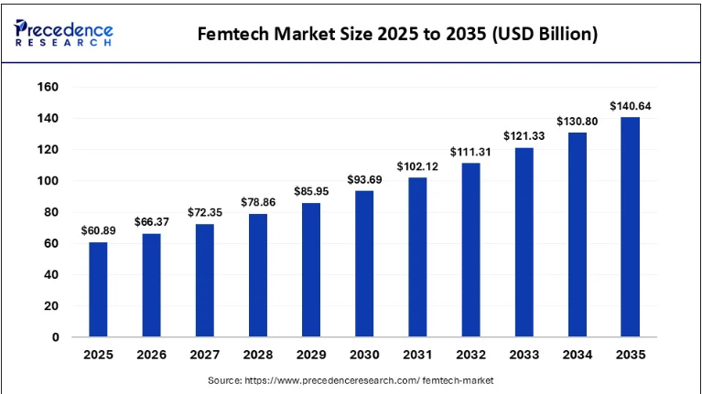
Market Predictions 2025-2035
MARQUETTE UNIVERSITY l College of Nursing I Boland Institute for NFP
Notes:
https://www.precedenceresearch.com/femtech-market

Slide 5
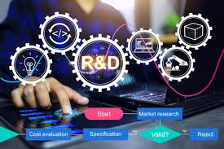
Research and Development
Areas of women’s health:
Maternal health
Menstrual care
Pelvic and sexual health
Fertility
Menopause
Contraception
Breast health
MARQUETTE UNIVERSITY l College of Nursing I Boland Institute for NFP
Notes:
In a Ted Talk Maaike Steinbach stated that about 27% of the digital health industry actually is dedicated to Research and Development and of that amount about 3% is exclusive to women’s health and femtech.
Currently the areas covered by the research are devices and apps that support:
Maternal health
Menstrual care
Pelvic and sexual health
Fertility
Menopause – wearable hotflash predictor
Contraception
Breast health – bra that helps detect breast cancer (developed by a business woman in Nigeria)
In the beginning research was focused on mobile health apps for fertility and menstrual tracking, today it has been expanded to AI prediction models for diagnostics and management of situations like perimenopause, PCOS, endometrial and women athletes performance management.

Slide 6
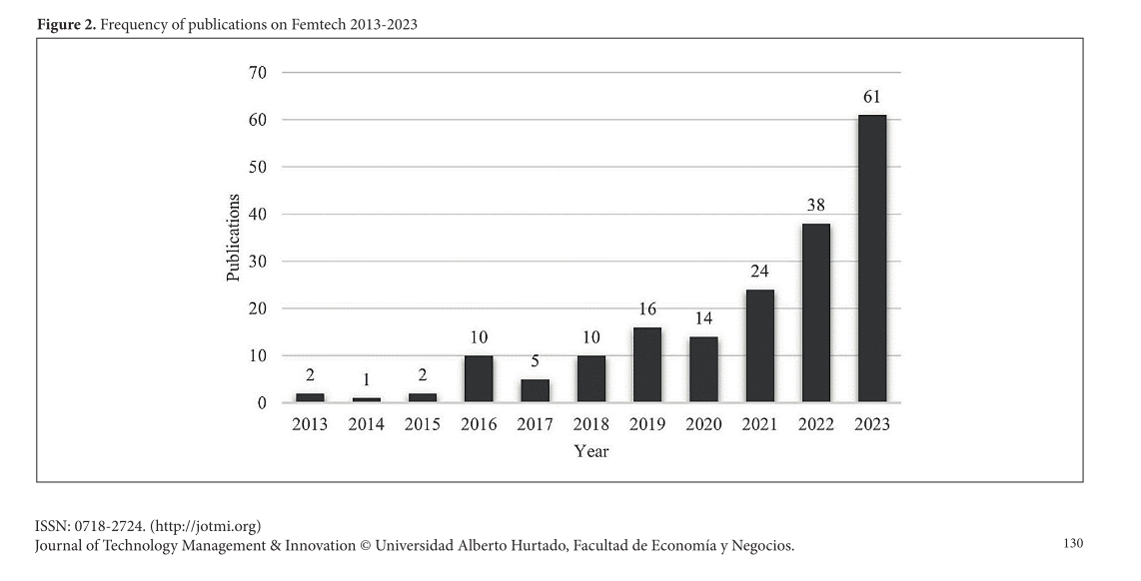
Publications in FemTech
.
MARQUETTE UNIVERSITY l College of Nursing I Boland Institute for NFP
Notes:
Scoping bibliometric review of FemTech research from 2013 to 2023. the authors found 183 articles primarily in medicine not in technology management.
you can see only a few publication in the first 3 years and by 2020 there are about 60 however, there is a significant jump after 2020. A jump that is suggested in the literature due to Covid and the lockdowns.
In the beginning research was focused on mobile health apps for fertility and menstrual tracking, today it has been expanded to AI prediction models for diagnostics and management of situations like perimenopause, PCOS, endometrial and women athletes performance management.
However, when compared to cardiovascular research published in the same time period the average number of articles per year is over 10,000. FemTech research is way behind.

Slide 7
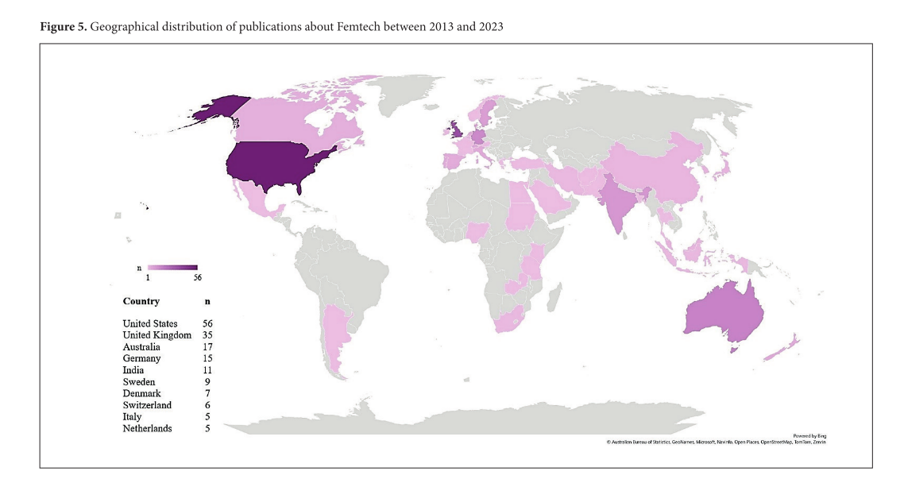
Geographic Distribution of Published Research
.
MARQUETTE UNIVERSITY l College of Nursing I Boland Institute for NFP
Notes:
Geographically the most research on femtech is coming from the US and the UK however, as you can see the number of publications is still dismal if you compare it to global cardiovascular research in the same time period (over the last 10 years) the US has had over 59,000 publications and the EU about 10,000. A significant difference in the number of research publications.
Bibliometric analysis comparisons.
Pre-print
Global Landscape of Cardiovascular Research: A Continental Bibliometric Analysis Standardized by Population and Physician Density
https://www.medrxiv.org/content/10.1101/2025.07.17.25331722v1.full

Slide 8
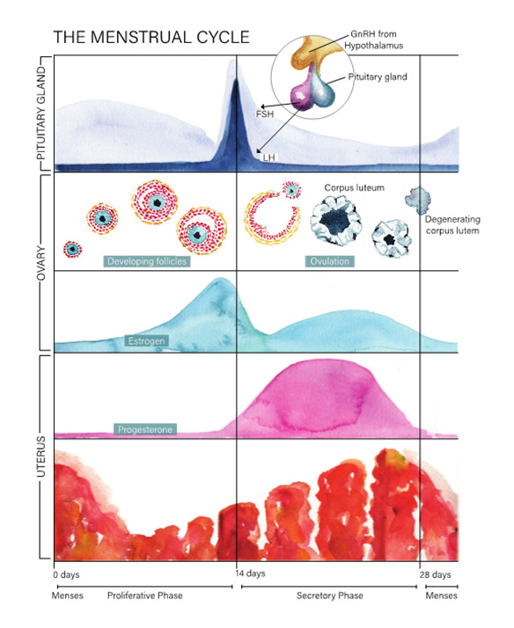

Natural Family Planning: Hormones
Primary hormones from the anterior pituitary gland:
Follicle stimulating hormone (FSH)
Luteinizing hormone
Primary hormones from the ovaries:
Estrogen
Progesterone
MARQUETTE UNIVERSITY l College of Nursing I Boland Institute for NFP

Slide 9
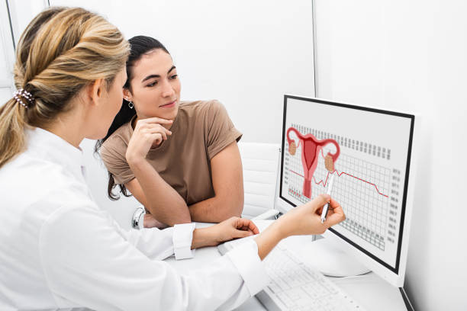
Devices and Apps
MARQUETTE UNIVERSITY l College of Nursing I Boland Institute for NFP
Notes:
Not an exhaustive list but these are some of the more commonly seen devices and apps we come across as Marquette Method Teachers. The ones that have been studies by the Boland Institute are:
Clearblue Fertility Monitor – Analog and Touchscreen – Fehring et all 2004 through 2023
PreMom app – Mu and Fehring
Mira – Bouchard, physician and doing his PhD looking at women in regular cycles using the Mira monitor and coming into the office for an ultrasound. He should have this work available for publication next year.

Slide 10
Categories of FemTech Fertility Systems
  Urine hormone devices
    qualitative
    quantitative
  Wearables
  mHealth apps
    period tracking apps
    paired data-tracking devices)
MARQUETTE UNIVERSITY l College of Nursing I Boland Institute for NFP

Slide 11
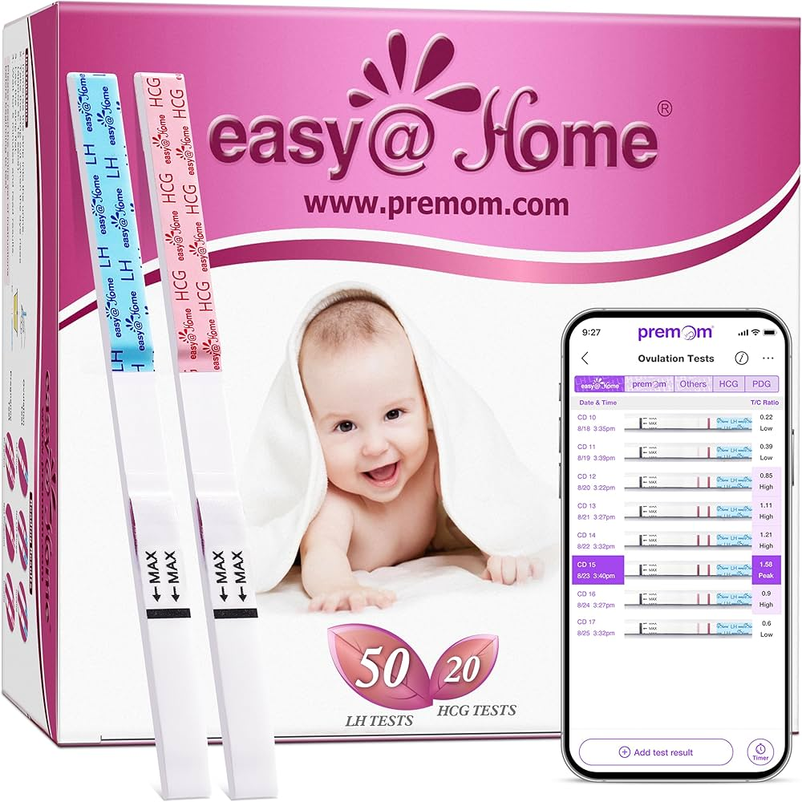
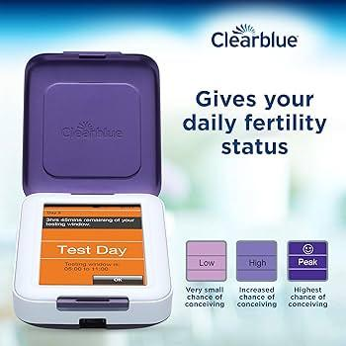
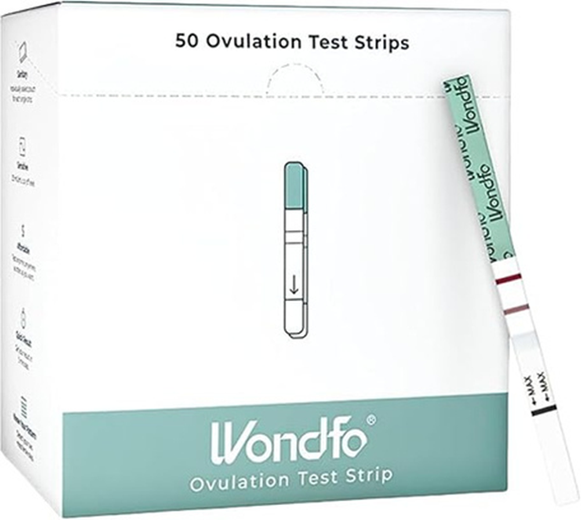
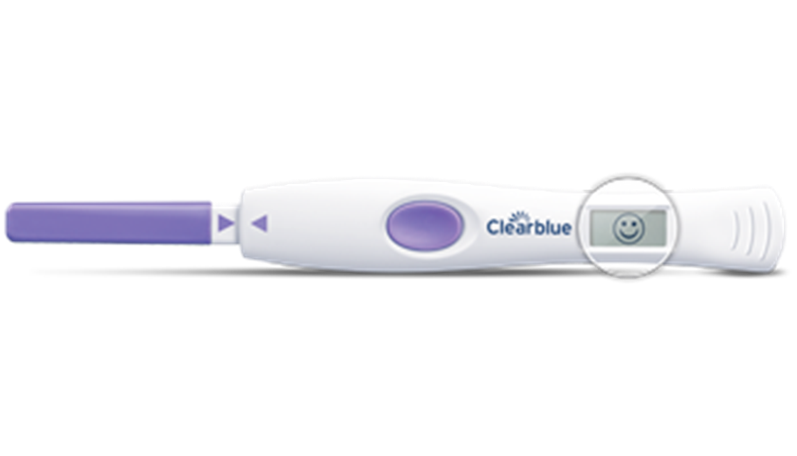

Urine Hormone Monitors: Qualitative
.
MARQUETTE UNIVERSITY l College of Nursing I Boland Institute for NFP
Notes:
Clearblue
Wodfo LH test strips - Barron et al., compared the peak of the monitor to the positive test of the LH strip and found that the LH correlated about 98% of the time. Meaning that when the Wondfo LH test showed a positive this occurred when the peak on the monitor was detected. There were 42 women who provided 219 cycles in this study.
Then there is PreMom which uses what is called the T/C ratio –explain the series of LH test strips in the app. 30 women who used the premom, easy at home and clearblue fertility monitor contributed 84 cycles. The peak day determined by the LH surge was found to correlate 99% of the time with all three systems. Thus, the premom app is often used as an inexpensive way to help women/couples find the LH surge and estimated day of ovulation.

Slide 12
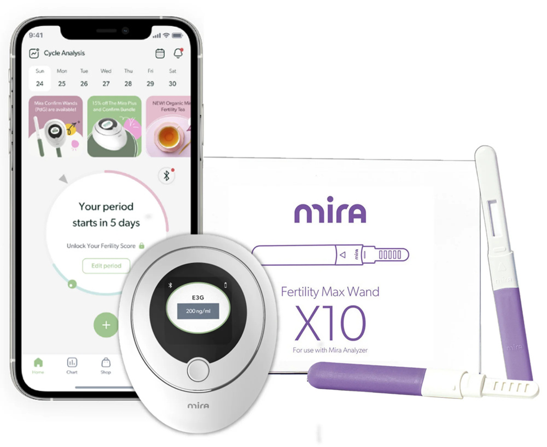
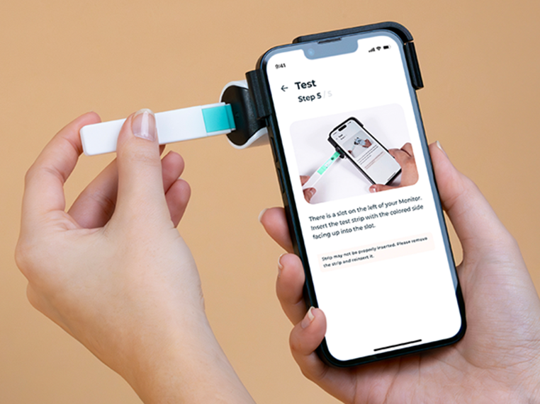

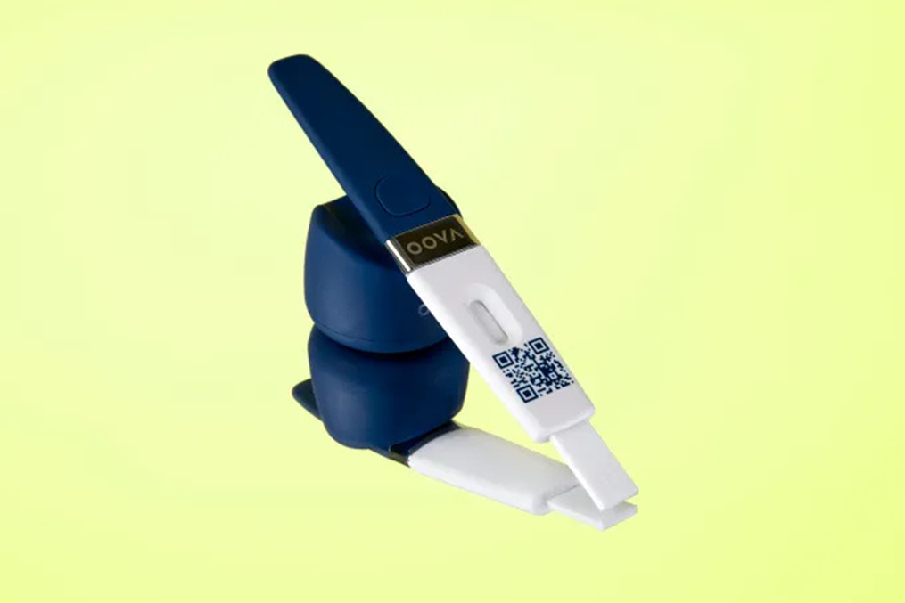

Urine Hormone Monitors: Quantitative
.
MARQUETTE UNIVERSITY l College of Nursing I Boland Institute for NFP
Notes:
Mira and Inito FSH, estrogen, LH and Progesterone
Oova - estrogen, LH and progesterone - primary target audience is women in perimenopause.

Slide 13
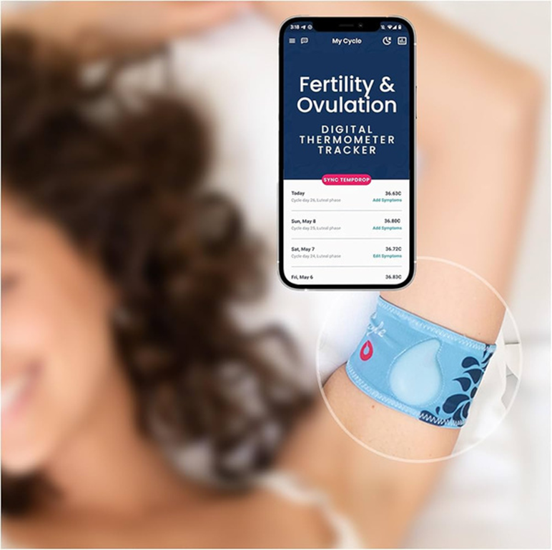
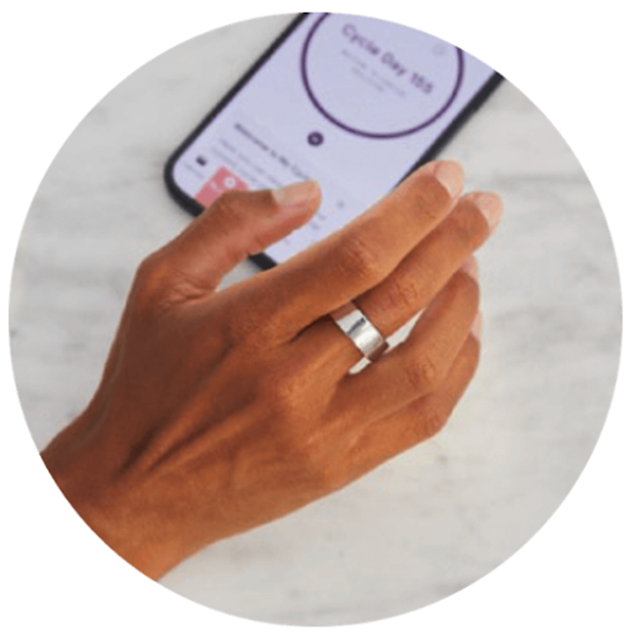
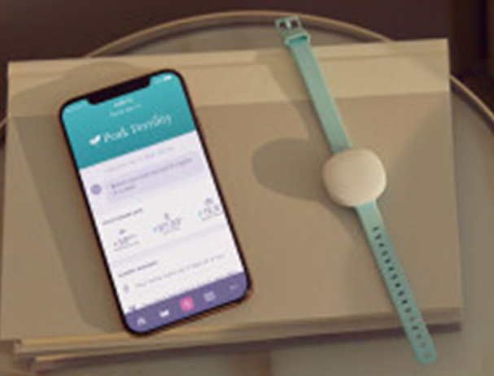
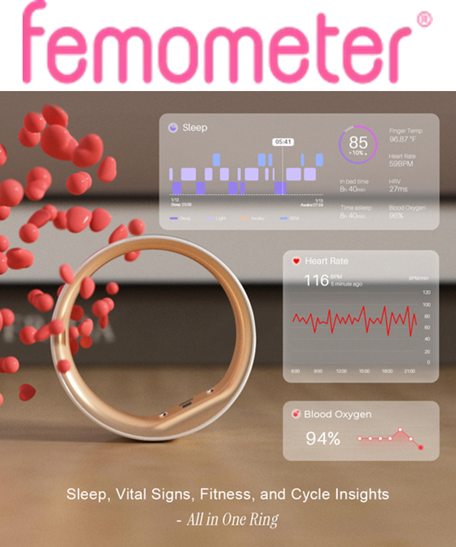



Wearable Devices
.
MARQUETTE UNIVERSITY l College of Nursing I Boland Institute for NFP
Notes:
Ring, bracelet or arm band all are using BBT as the biomarker it is tracking. A narrative review of the literature that looked at these devices ability to find the fertile window found that the majority of effectiveness studies were authored by company employees. A significant concern for bias. One strength of these devices however, might be the wearables could take much of the variability out of BBT methods like the common problem of past studies that did not have women using the same time, route or device.

Slide 14
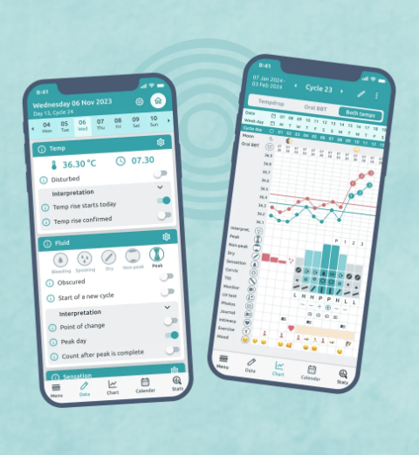
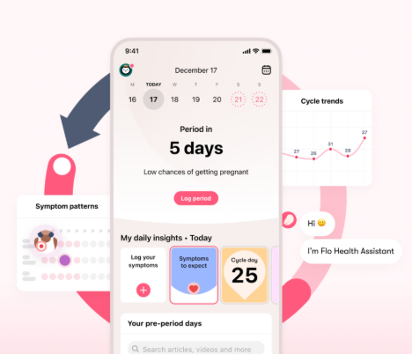
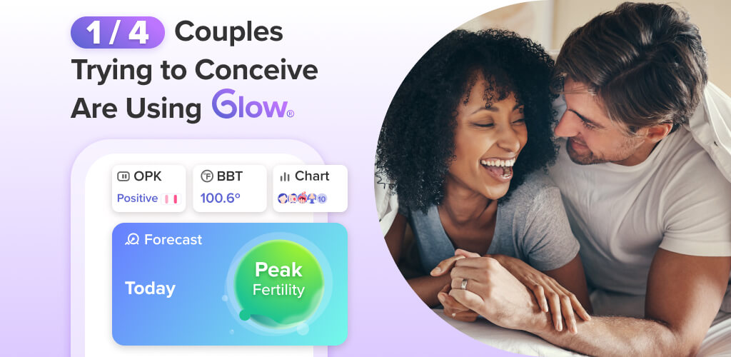

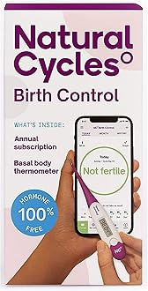
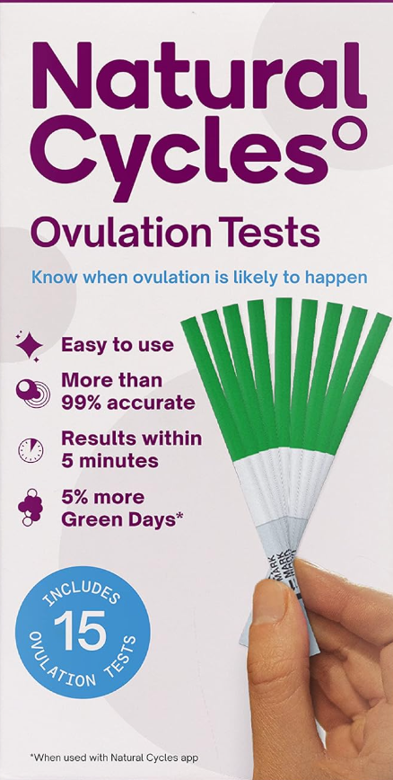


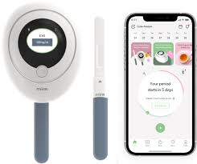


Fertility Apps
.
MARQUETTE UNIVERSITY l College of Nursing I Boland Institute for NFP
Notes:
Then there are fertility/menstrual tracking apps. Clue plus has partnered with wearable companies like
Natural cycles is actually the only one that is FDA approved. You can also see from the example of the Mira monitor here it does have an app that the device bluetooths to and the results will go to what is called the doctors portal where a doctor or nurse can see the data plotted out in graphs.
Read Your Body – tool for women to chart their signs of fertility and is used by Marquette Method Teachers
Flo - Over 420 million people³ around the world use the Flo app to track their periods, ovulation, pregnancy, and perimenopause. Calendar method uses the first day of your last menstrual period and the average cycle length.
Ovia - is a digital platform that supports men and women through tracking BBT and cervical mucus symptoms but is also has a library of information to support the woman and couple through pregnancy and parenting.

Slide 15
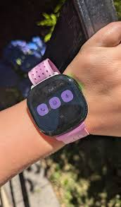


Period tracking apps: paired to a wearable
Google Fitbit
(Clue Plus)
MARQUETTE UNIVERSITY l College of Nursing I Boland Institute for NFP
Notes:
Clue plus
https://helloclue.com/landing/wearables

Slide 16
Top 5 Fertility Apps
Clue: A science-backed app that is often rated highly for its accuracy and features.
Flo: A feature-rich app that can help users track their fertile window and understand their cycle patterns.
Glow: Another popular option that offers fertility tracking and a supportive community.
Ovia Fertility & Cycle Tracker: A well-regarded app that helps with fertility and cycle tracking.
Natural Cycles: Marketed as a birth control method, it can also be used for fertility tracking.
MARQUETTE UNIVERSITY l College of Nursing I Boland Institute for NFP
Notes:
These apps are considered to be the most popular and downloaded fertility apps however, of concern with most of these apps is the lack of personal health care support. Although, I did see Ovia does provide support through a “care team”.

Slide 17

MARQUETTE UNIVERSITY l College of Nursing I Boland Institute for NFP
Notes:
Youtube video https://youtu.be/aRCqixvrcOQ?si=EN5IaZ0AOTZQONx_

Slide 18
Protection of PHI in Femtech Apps
FDA guidelines – Classifications are:
  MMA is a medical device, serious health risk.
  MMA is a medical device, low – moderate health risk
FTC guidelines – Users should know how their data will be used.
HHS - HIPAA
Allysan Scatterday, This is No Ovary-Action: Femtech Apps Need Stronger Regulations to Protect Data and Advance Public Health Goals, 23 N.C. J.L. & Tech. 636 (2022). Available at: https://scholarship.law.unc.edu/ncjolt/vol23/iss3/6
MARQUETTE UNIVERSITY l College of Nursing I Boland Institute for NFP
Notes:
Not under FDA – because this department protects consumers from medical devices however, they are supposed to over see Mobile Medical apps (MMA) classification .
FTC – is supposed to protect the consumer from having their data sold, their job is to prevent the consumer from being mislead. - They want to make sure that consumers are informed where their PHI is and how it is protected. This should be in the Privacy policy and easy to find and understand.
Food and Drug Administration
Federal Trade Commission
Health and Human Services
HIPAA – storage and transfer of PHI.

Slide 19
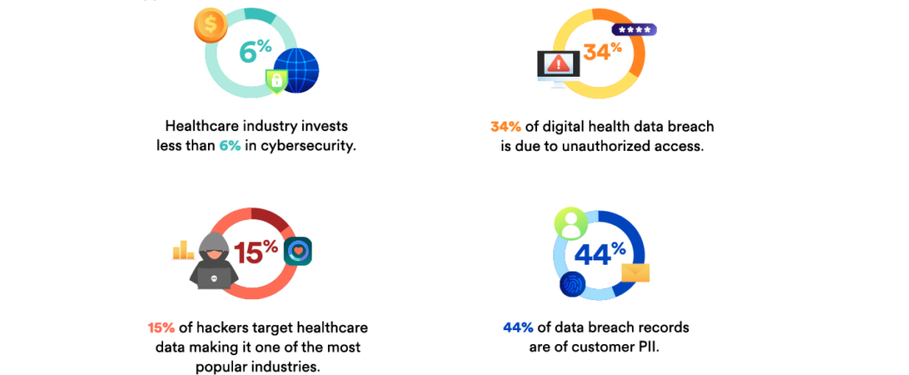
Ethical Concerns as a NFP Teacher: Using FemTech
MARQUETTE UNIVERSITY l College of Nursing I Boland Institute for NFP
Notes:
Key Takeaways from the Article - Kelly t al. 2025
Period-tracking applications (PTAs) and paired data-tracking devices have become popular tools for promoting reproductive health, but they present significant concerns regarding the privacy of sensitive health data .
The current legal landscape provides inadequate coverage to ensure user safety, leaving the collection, usage, management, and disclosure of data to be determined by company leaders .
The Federal Trade Commission (FTC) has regulatory mechanisms to hold PTAs accountable, but security concerns remain, especially after the Dobbs v. Jackson Supreme Court decision that overturned Roe v. Wade .
Recommendations include amending HIPAA to include PTAs as "covered entities", establishing federal protections for reproductive health data privacy, strengthening federal agency oversight, enhancing state-level oversight, and improving industry self-regulation .

Slide 20
Summary of gaps:
Marketing has outpaced human subject’s research.
Regulatory bodies have traditionally taken a hands-off approach to tighter regulations due to legislative bodies supporting the market to support research.
Secular market
MARQUETTE UNIVERSITY l College of Nursing I Boland Institute for NFP

Slide 21
Future of FemTech: Fertility Monitoring
Devices and apps are tools they don’t replace the NFP teacher.
Data security - is the couple aware of where their data is or will go once it is in the app?
Rigorous human subject RESEARCH desperately needed.
Regulatory guidelines to secure PTA PI data that blue tooths to devices.
Quantitative urine hormone monitoring devices with fertility charting have the potential to intersect with mainstream medical management in a way that can revolutionize women’s/couples’ fertility healthcare.
MARQUETTE UNIVERSITY l College of Nursing I Boland Institute for NFP
Notes:
Key Takeaways from the Article - Kelly t al. 2025
Period-tracking applications (PTAs) and paired data-tracking devices have become popular tools for promoting reproductive health, but they present significant concerns regarding the privacy of sensitive health data .
The current legal landscape provides inadequate coverage to ensure user safety, leaving the collection, usage, management, and disclosure of data to be determined by company leaders .
The Federal Trade Commission (FTC) has regulatory mechanisms to hold PTAs accountable, but security concerns remain, especially after the Dobbs v. Jackson Supreme Court decision that overturned Roe v. Wade .
Recommendations include amending HIPAA to include PTAs as "covered entities", establishing federal protections for reproductive health data privacy, strengthening federal agency oversight, enhancing state-level oversight, and improving industry self-regulation .
Kelly, B. G., Junchaya, O., Min, J., & Burdan, M. (2025). Safeguarding autonomy: Examining the complexities and implications of under-regulated period-tracking apps and paired devices in a post-Roe landscape. Contraception, 110981. Advance online publication. https://doi.org/10.1016/j.contraception.2025.110981

Slide 22
References
https://helloclue.com/about-clue
https://www.fledge.net/revolutionizing-femtech-meeting-with-ida-tin-2/
https://startupiceland.com/2017/03/03/ida-tin-founder-profile-si2017/
https://www.moengage.com/blog/digital-health-data-protection-on-engagement-platforms/
https://readyourbody.com/
https://flo.health/
https://www.oviahealth.com/blog/fertility-cycle-tracker/fertility-period-tracker/
https://www.jotmi.org/index.php/GT/article/view/4586
https://pubmed.ncbi.nlm.nih.gov/36807364/
https://www.precedenceresearch.com/femtech-market
MARQUETTE UNIVERSITY l College of Nursing I Boland Institute for NFP

Slide 23

Notes:
Content Slide Marquette Blue: This layout would best be used for slides that are heavy on content.
Titles should always be “Marquette Gold” (same color as the corner), with the content below it in white. “Marquette Gold” can also be used to accentuate a word or section of your slide but should not be used heavily throughout. Bullets should always be square to connect with the refreshed brand style.

